Slide 1
Air Quality Mapping
Major Project
Robert Mouncer (rdm10@aber.ac.uk)

Slide 2
Brief Overview
The Air Quality Mapping project will develop a monitoring and visualisation system for air pollution on public roads and in public areas.

Slide 3
Why am I doing this?
40,000 deaths annually in the UK (1.6m in China)
Ways to reduce outdoor air pollution - “Monitor air pollution effectively” and to use the results to communicate “proactively to the public”
Links back to industrial year
The Royal College of Physicians (Published 2016) - Every breath we take: the lifelong impact of air pollution, Accessed – 01/02/2018 https://www.rcplondon.ac.uk/projects/outputs/every-breath-we-take-lifelong-impact-air-pollution

Slide 4
Brief Overview - Monitoring
A device will be designed and created to measure air quality levels and record a GPS location. The device should be a Raspberry Pi with compatible modules needed to take the measurements.
The data should be uploaded to a server or online storage when connected to a known network.
Should be small and portable (designed for vehicles)

Slide 5
Brief Overview - Monitoring
Measuring TVOC in the atmosphere
TVOC’s both man-made and naturally occurring
Are generated when burning fossil fuels, aerosols and much more!

Slide 6
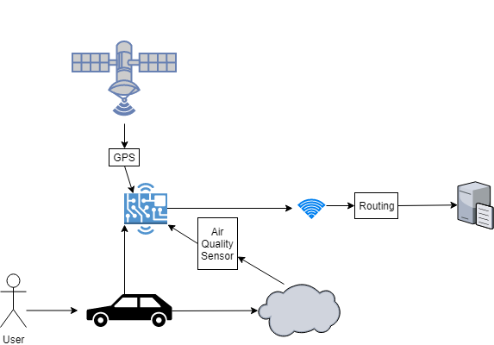
Monitoring

Slide 7
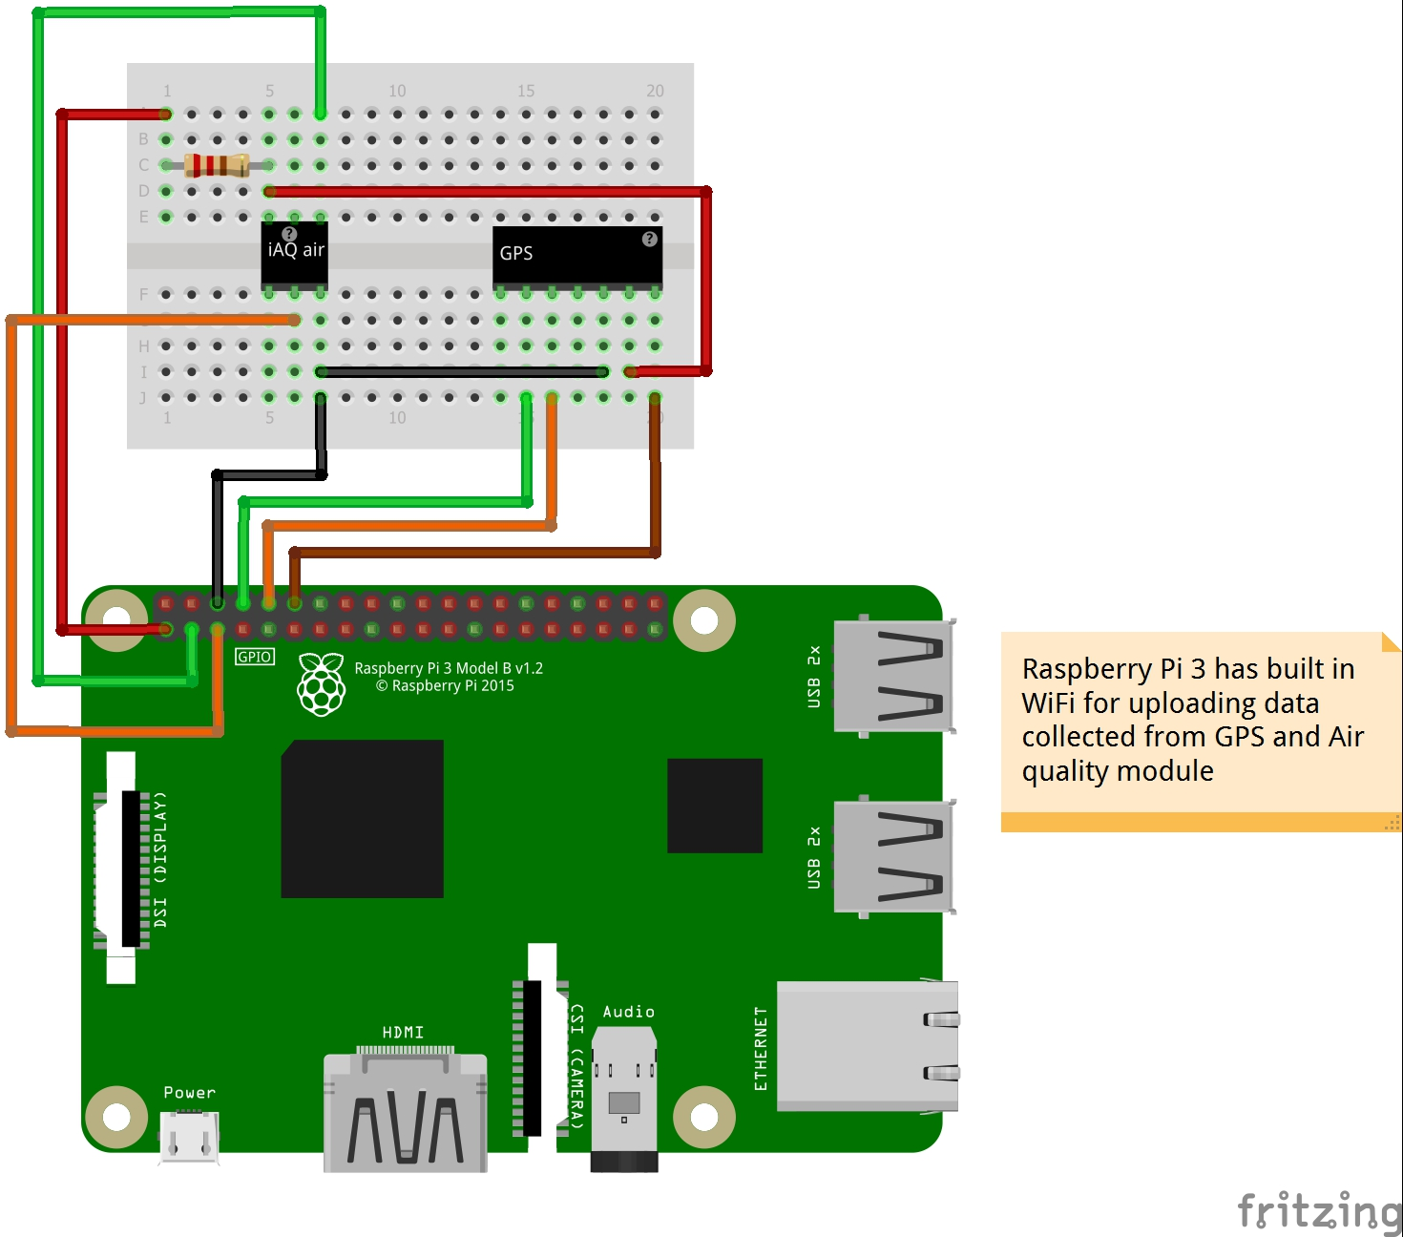
Hardware Design

Slide 8
Brief Overview – Visualisation
Use of an online map provider API
Overlay a contour map to show the pollution levels in different areas
Much like a similar product:
https://breezometer.com/air-quality-map/
Needs to be easy to use to allow proactive learning for the public

Slide 9
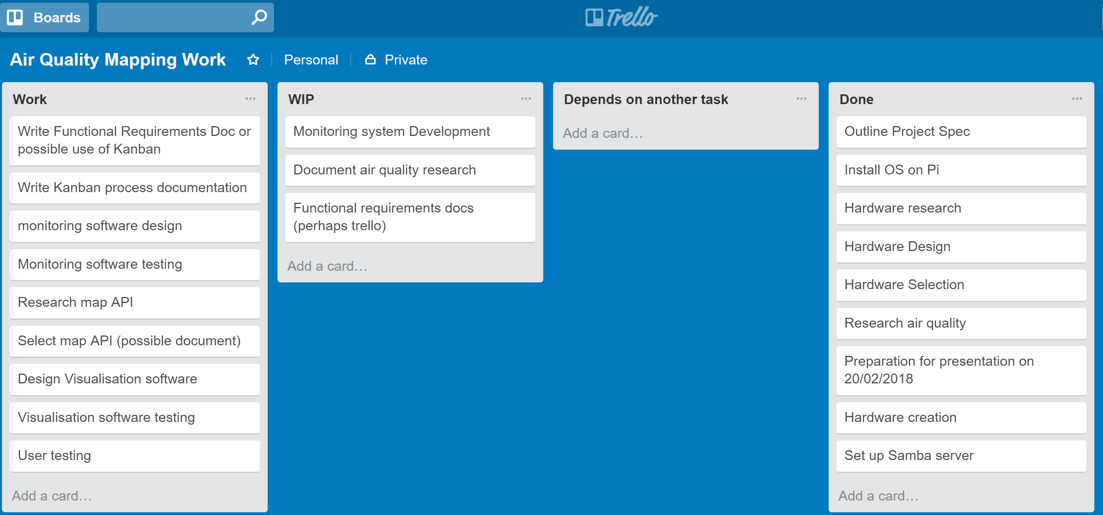
Use of Kanban

Slide 10
Where am I now?

Slide 11
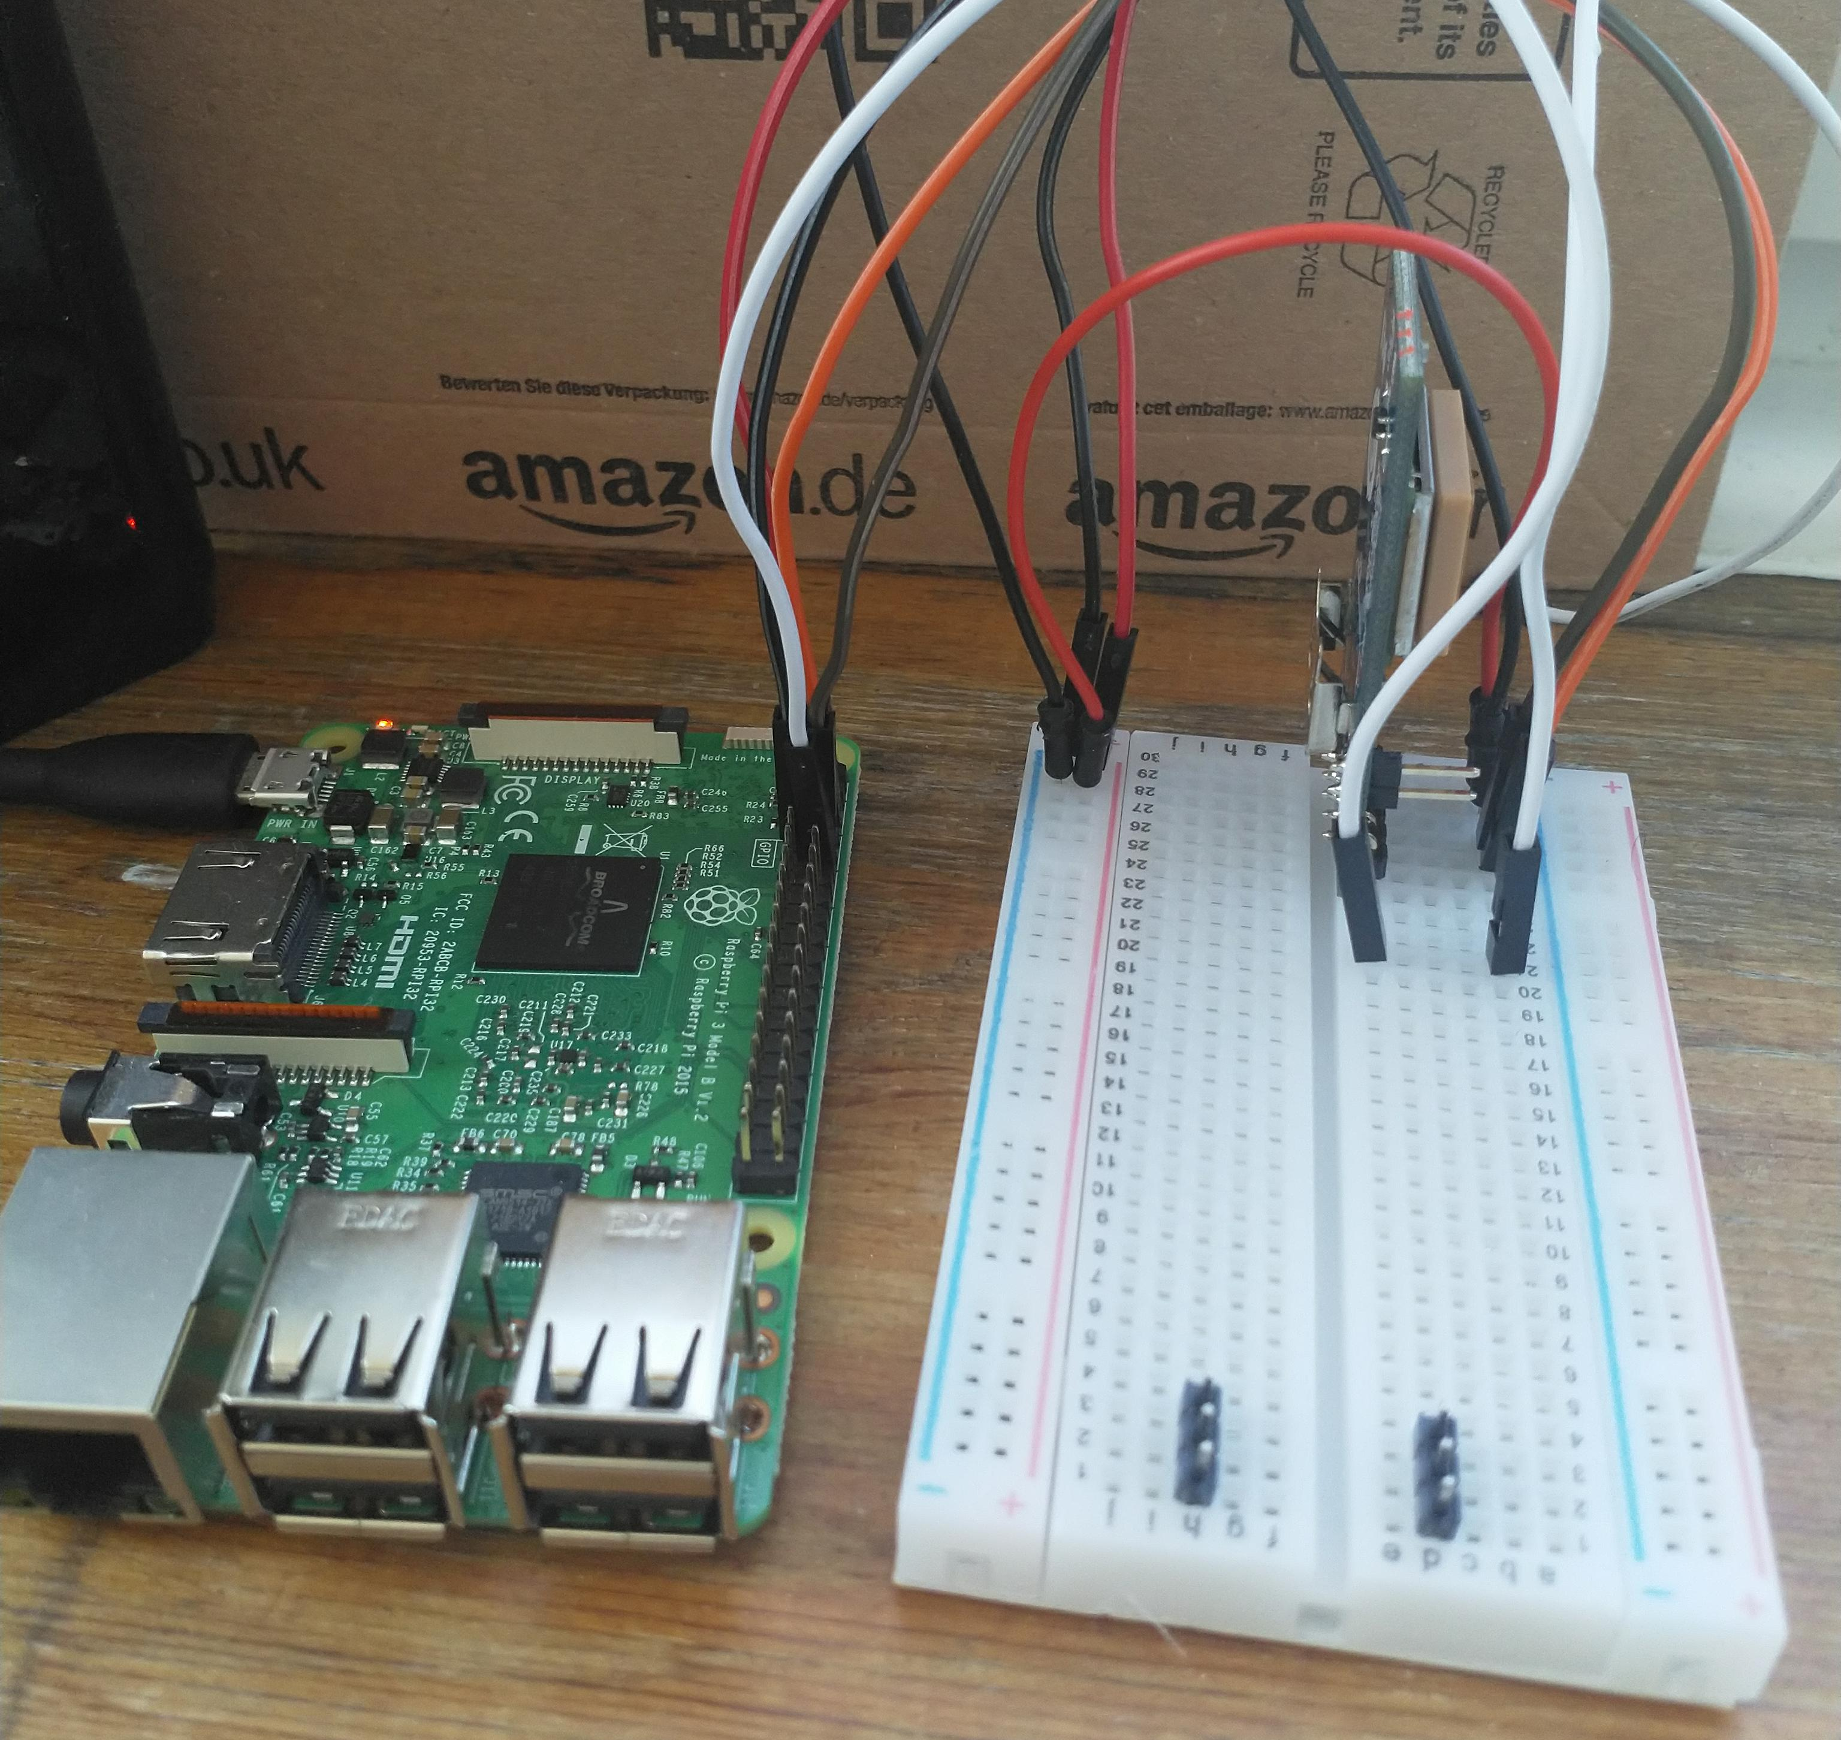
The Pi environment
Raspbian Lite
Use of SSH
Samba server

